Slide 1

Deep learning, Neural Networks, and Reinforcement learning Prof. Bagdanov Prof. Seidenari
Self-Driving Cab in a Simple EnvironmentProject Luca Pennella

Slide 2
Introduction
Reinforcement Learning (RL) is the science of making optimal decisions using experiences. the The process of RL involves these simple steps:
Observation of the environment
Deciding how to act using some strategy
Acting accordingly
Receiving a reward or penalty
Learning from the experiences and refining our strategy
Iterate until an optimal strategy is found
Project Luca Pennella

Slide 3
The Project: Self-Driving Cab
The major goal is to demonstrate how you can use Reinforcement Learning techniques to develop an efficient and safe approach for tackling Self-Driving problem.
The Smartcab's job is to pick up the passenger at one location and drop them off in another.
Project Luca Pennella

Slide 4
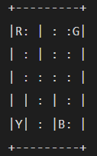
State Space
The State Space is the set of all possible situations in which the agent must perform an action.
The parking lot is break up into a 5x5 grid, which gives us 25 possible taxi locations. There are five locations that we can pick up and drop off a passenger: R, G, Y, B.
There's four (4) destinations and five (4 + 1) passenger locations, because the passenger can stay into the taxi at the start of episode.
So, our taxi environment has 5x5x5x4=500 total possible states.
Project Luca Pennella
Notes:
In Reinforcement Learning, the agent encounters a state, and then takes action according to the state it's in

Slide 5
Action Space
The action in our case can be to move in a direction or decide to pickup/dropoff a passenger
There are 6 discrete deterministic actions:
0: move south
1: move north
2: move east
3: move west
4: pickup passenger
5: drop off passenger
This is the action space: the set of all the actions that our agent can take in a given state.
Project Luca Pennella

Slide 6
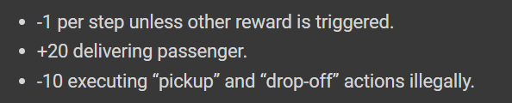
Rewards
The agent should receive a high positive reward for a successful dropoff because this behavior is highly desired
The agent should be penalized if it tries to drop off a passenger in wrong locations
The agent should get a slight negative reward for not making it to the destination after every time-step. Slight negative because we would prefer our agent to reach late instead of making wrong moves trying to reach to the destination as fast as possible
The reward in our project follows the ideas from the bullet points above.
Project Luca Pennella

Slide 7
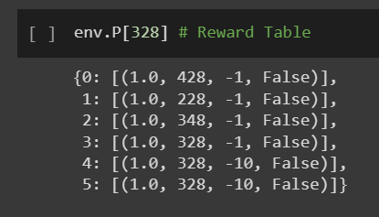
The Reward Table
There is an initial Reward table that's also created, called P. We can think of it like a matrix that has the number of states as rows and number of actions as columns. We can see the default reward values assigned to our illustration's state:
This dictionary has the structure
action: [(probability, nextstate, reward, done)].
Project Luca Pennella
Notes:
The 0-5 corresponds to the actions (south, north, east, west, pickup, dropoff) the taxi can perform at our current state in the illustration.
The nextstate is the state we would be in if we take the action at this index of the dict

Slide 8
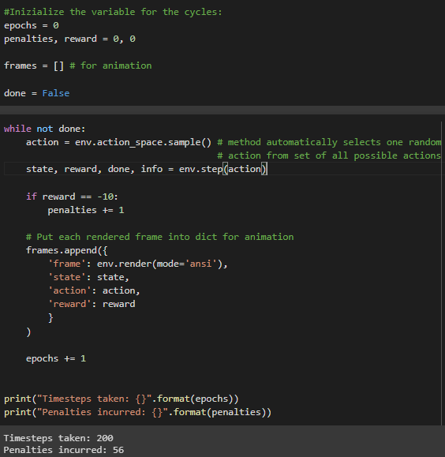
Solving the environment without Reinforcement Learning
We have our rewards table for default rewards in each state, we can try to have our taxi navigate just using that.
Agent takes thousands of timesteps and makes lots of wrong drop-offs.
The agent has no memory of which action was best for each state, which is exactly what RL will do for us.
Project Luca Pennella

Slide 9
Q-learning: Q-values
The agent make decision by looking receiving a reward for taking an action in the current state, then updating a Q-value to remember if that action was beneficial. The values are stored in the Q-table, and they map to a (state, action) combination.
We are learning the proper action to take in the current state by looking at the reward for the current state/action combo, and the max rewards for the next state.
The way we store the Q-values for each state and action is through a Q-table
Project Luca Pennella
Notes:
The learned value is a combination of the reward for taking the current action in the current state, and the discounted maximum reward from the next state we will be in once we take the current action.

Slide 10
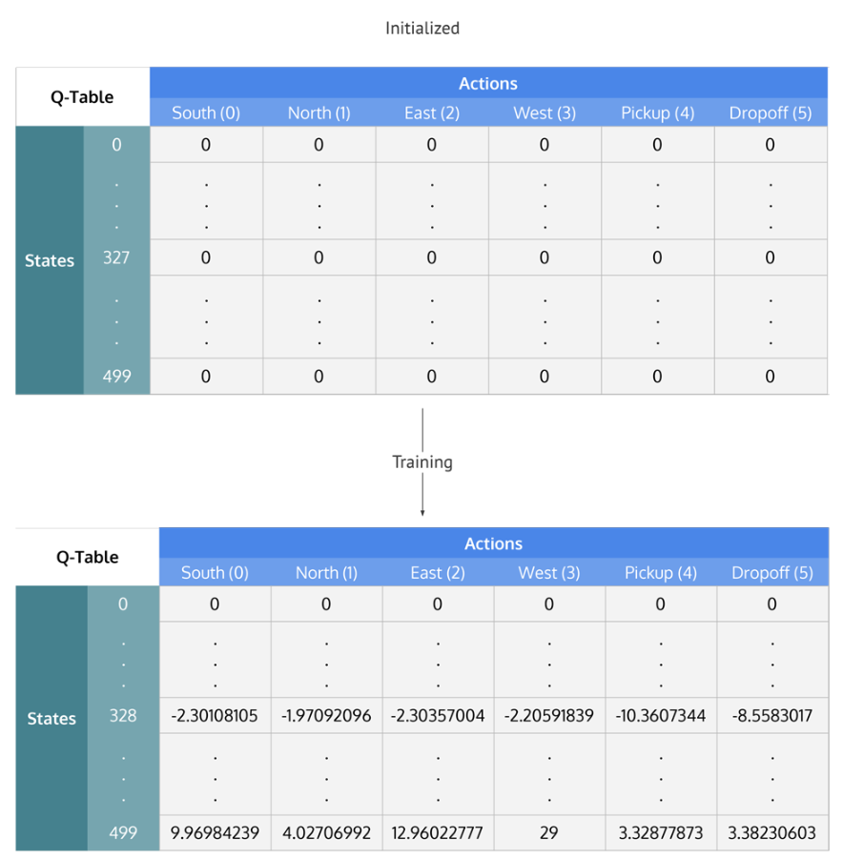
Q-learning: Q-table
The Q-table is a matrix where we have a row for every state (500) and a column for every action (6). It's first initialized to 0, and then values are updated after training.
Project Luca Pennella

Slide 11
Q-Learning Process
Initialize the Q-table by all zeros.
Start exploring actions: For each state, select any one among all possible actions for the current state (S).
Travel to the next state (S') as a result of that action (a).
For all possible actions from the state (S') select the one with the highest Q-value.
Update Q-table values using the equation.
Set the next state as the current state.
If goal state is reached, then end and repeat the process.
Project Luca Pennella

Slide 12
Exploiting learned values
There's a trade-off between exploration (choosing a random action) and exploitation (choosing actions based on already learned Q-values). We want to prevent possibly overfitting, so we'll be introducing another parameter called ε to cater to this during training.
Project Luca Pennella

